Slide 1
Introduction to 8086 Microprocessor (part 2)
The Intel Microprocessors 8th Edition by Barry B Brey
Section 9-1 Pin-Outs and the Pin Functions page 305
Arnab Bhattacharjee
Lecturer, Department of CSE,
United International University
Email id : arnab@cse.uiu.ac.bd
Courtesy: Nasif M. Sir,
Md. Shafqat Talukder Rakin Sir

Slide 2
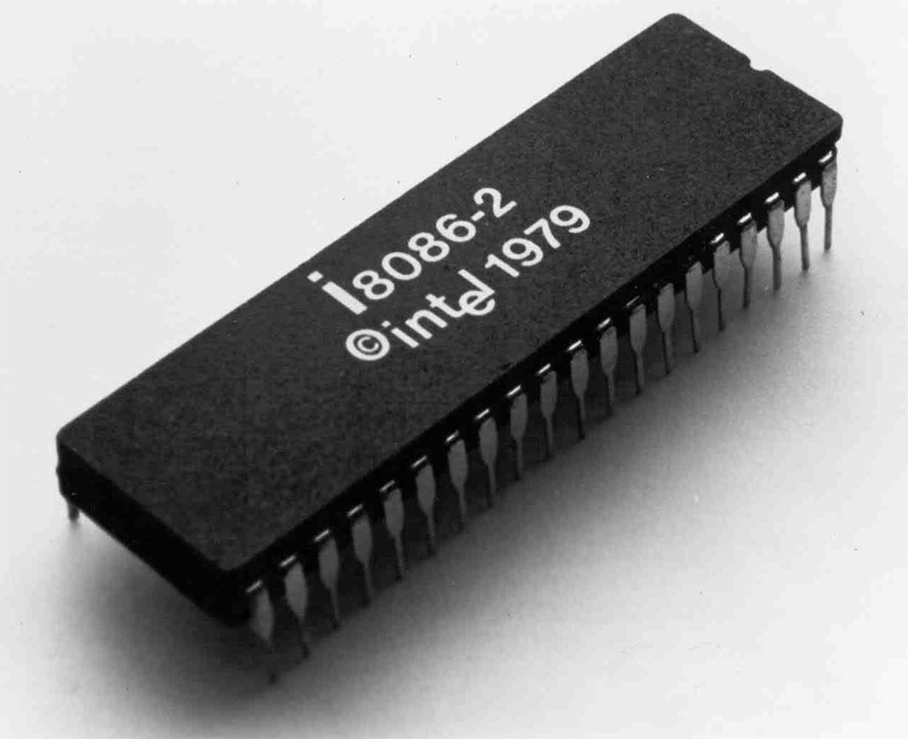

Slide 3
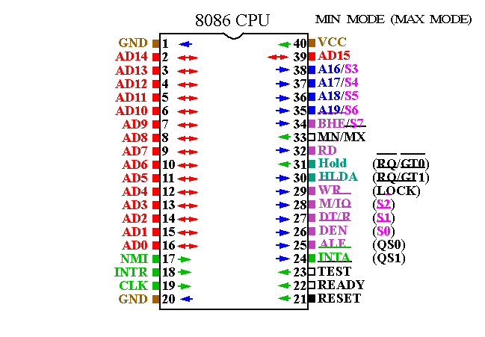
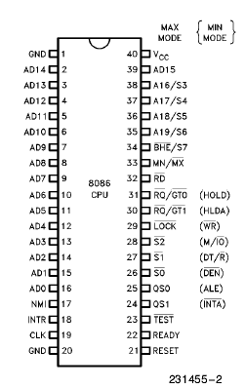
8086 Pin Diagram

Slide 4
Pin Description
AD0-AD15: Multiplexed Address/Data Bus
RD’: Low while reading from memory or port
WR’ : Low while writing to memory or port
ALE : Address latch enable shows 8086 data bus contains address information. This address can be a memory or I/O device
M/IO’ : High during Memory operations.
Low during I/O Port operations.
RESET: causes the processor to immediately terminate its present activity. The signal must be active HIGH for at least four clock cycles. It restarts execution.

Slide 5
Pin Description
CLK : The clock pin provides the basic timing signal to the microprocessor
VCC: This power supply input provides a +5.0 V ±10 % signal to the microprocessor.
GND: The ground connection is the return for the power supply. Note that the 8086 microprocessors have two pins labeled GND—both must be connected to ground for proper operation.

Slide 6
Pin Description
DT/R’ : The data transmit/receive signal shows that the microprocessor data bus is transmitting (DT/R’ ) or receiving (DT/ R’) data. This signal is used to enable external data bus buffers.
DEN’: Data bus enable activates external data bus buffers.
BHE’/S7: The bus high enable pin is 0 used to enable the most-significant data bus bits (D15–D8) and 1 to enable data bus bits (D7–D0) during a read or a write operation. The state of S7 is always a logic 1.
READY: The READY input is controlled to insert wait states into the timing of the microprocessor. If the READY pin is placed at a logic 0 level, the micro-processor enters into wait states and remains idle. If the READY pin is placed at a logic 1 level, it has no effect on the operation of the microprocessor.

Slide 7
Pin Description
A19/S6–A16/S3 : The address/status bus bits are multiplexed to provide address signals A19–A16 and also status bits S6–S3.
During the first clock period of a bus cycle, the entire 20-bit address is available on these lines. During all other clock cycles for memory and I/O operations, AD15-AD0 contains the 16-bit data, and S3, S4, S5, and S6 become status lines.
After the first clock cycle of an instruction execution, the A17/S4 and A16/S3 pins specify which segment register generates the segment portion of the 8086 address. Thus, by decoding these lines and using the decoder selects the memory chips.
S5 reflects the contents of the IF flag. S6 is always held at 0 and indicates that an 8086 is controlling the system bus.

Slide 8
Pin Description
S3 and S4 lines are decoded as follows:
A17/S4 | A16/S3 | Function
0 | 0 | Extra segment access
0 | 1 | Stack segment access
1 | 0 | Code segment access
1 | 1 | Data segment access

Slide 9
Thank You

